Slide 1



WARZONE SOEN 6441 (Advance Programming Practices)
Build 3
Kapil Soni(40290467)
Meet Boghani(40294571)
Tejasvi Tejasvi(40292854)
Nishith Soni(40289556)
Bharti Chhabra(40294202)
Yesha Shah(40290892)

Slide 2
Table of Contents
About Project
Phases of the game
MVC Architecture and Data Driven Architecture
Folder Structure
Class Diagram
Game Flow
Continuous Integration
Code Layout
Commenting Convention
Test Cases

Slide 3
About Project
In this project, we are developing Warzone using the Extreme Programming approach. The Warzone is produced by adhering to its features, which include continuous integration, pair programming, communal ownership, and testing.
Specifically, we are using the incremental development strategy here, releasing builds with fewer features at a time. Furthermore, the Model View Controller (MVC) architecture was used in the development of this game.

Slide 4

Phases
Map Loader Phase
StartUp Phase
Reinforcement Phase
Issue Order Phase
Execute Order Phase
Map Editor Phase

Slide 5
MVC Architecture and Data Driven Architecture
The primary architecture used in our project is the combination of Data Driven Architecture and Model View Controller Architecture.
MVC is a design pattern, and it is used widely used in software development.
Model represents the data and business logic of application.
View is the user interface and the presentation part.
Controller handles the input from the user and then updates the model.

Slide 6
Goals of MVC Architecture
Clear Separation: MVC enforces a strong separation between data logic (Model), presentation (View), and interaction handling (Controller).
Data Focus: Data-driven development emphasizes the significance of data structures even more. Together, these strategies provide modular code that is problem specific.
Easier Modification: Views and controllers are less affected by changes to your data storage strategy, and vice versa. This greatly improves the smoothness of updating or adding new feature.
Parallel Development: Data-driven design combined with MVC makes it easier for teams to work on several project areas at once.
Collaboration: Having distinct roles and duties promotes better team communication and understanding.

Slide 7
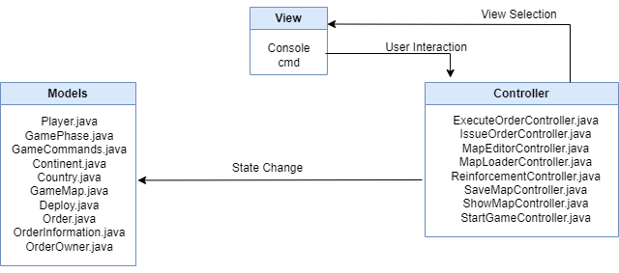
Model-View-Controller

Slide 8
Primary Design Patterns
Observer: The logger is implemented using the observer pattern.
The class implements the interface, so whenever changes occurs it is notified, and it logs the changes to the file.
This allows us to keep track of all the changes that occur in the game, which can be useful for debugging and troubleshooting changes.
This method logs each and every changes occurring to a file.

Slide 9
Primary Design Patterns
State: We used the state pattern to create a flexible architecture for the game phases.
GamePhase abstract class defines the interface, with concrete subclasses for each phase.
GameEngine manages the game phases, managing the current phase and the next phases in the queue.
GameEngine observer phase changes and updates the game state accordingly.

Slide 10
Primary Design Patterns
Command: This was implemented to model various unit orders. Each order is represented by concrete Command class, encapsulating the execution logic.
It offers benefits such as encapsulation, reusability, and undo/redo capabilities.
The Command pattern, provides a structured way to manage and execute the orders in the game, enabling maintenance and flexibility.

Slide 11
Primary Design Patterns
Adapter: This enables the seamless integration between the classes that have similar capabilities but incompatible interfaces.
A MapAdapter class is created and acts as a bridge between the GameMap and the ConquestMapReader.
The interface that the GameMap expects is implemented by the MapAdapter. An instance of the ConquestMapReader is contained inside the MapAdapter.
The MapAdapter interacts with the GameMap by translating the requests, invoking the appropriate ConquestMapReader methods, and formatting the returned data in accordance with the GameMap’s expectations.

Slide 12
Primary Design Patterns
Strategy: With this you can modify player behavior in your game on the fly. There are other strategies available such as “Aggressive”, ”Benevolent”. And “Cheater” each of which specifies how a player created commands.
These tactics are used by a central “OrderCreator” who is unaware of the particulars of each one.
This makes it simple to add new player kinds, modify player behavior on the fly, and maintain code organization.

Slide 13

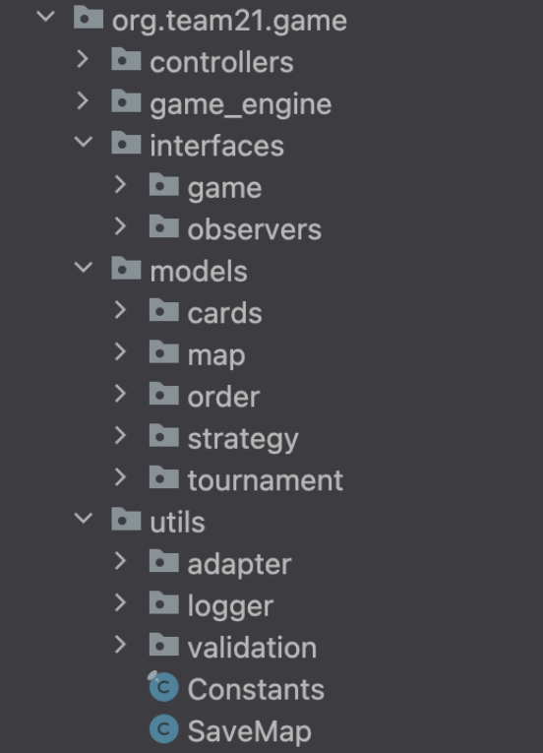

Folder
Structure

Slide 14
controllers: This module will take care of all controllers which will handle the core game phases feature.
game_engine: All of the game’s phases will be handled by GameEngine in a way that ensures each one proceeds in the correct order.
interfaces: The other classes will receive schema from the interfaces. Interfaces have been used for GamePhase in addition to Observer, state, and Command pattern for Logger, GamePhase, and Orders.
models: The development, maintaining, and preservation of the gameplay, map, and order codes have all been done with the help of the models. It also has a number of ways to manipulate different game components.
utils: Constants will be stored in the utils subdirectory. Java, which contains all of the hardcoded string constants and the team name. Common features that users should see to help them during ordering and other stages. In addition, Logger is used here to maintain track of each and every log file. Furthermore, the utils class also manages validations for various game phases.

Slide 15
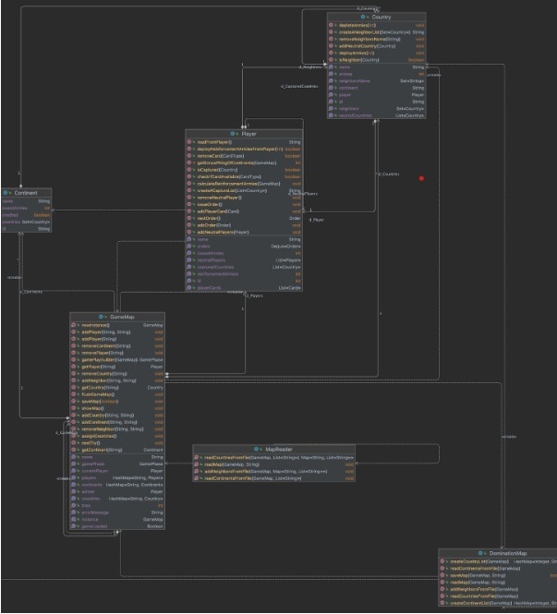
Maps

Slide 16
GameMap: Game map information is stored in the map class. To access continents, countries, and their neighboring places on the map, it consists of data structures.
Continent: This class stores data on ContinentIDs, Control Values, and the country on each continent. Every nation that is a part of a single continent is stored in a hashmap, with the object serving as the value and the CountryID as the key.
Country: A nation is represented by this class on a global map. Every nation contains an ID, index, parent continent, neighbors, army count, and coordinates for the CMD display.

Slide 17
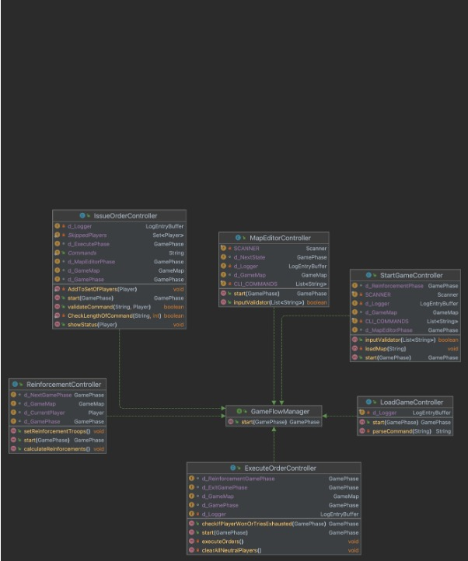
Controllers

Slide 18
Controller Classes
StartGameController.java
LoadMap
ShowMap
Add or remove Gameplayer
Assign countries
Start reinforcement phase
ReinforcementController.java
Assign troops
Calculate armies

Slide 19
Controller Classes
IssueOrderController.java
Get data from CMD
Controls how many players are remaining
Stores data and Order interface and child methods
ExecuteOrderController.java
Execute all the players
Check neutral players
Check if countries are won by players
Change phase of game to exit or reinforcement

Slide 20
Controller Classes
MapEditorController.java
Create a map if not exists
Edit map
Add/Remove continents
Add/Remove neighbours
Add/Remove countries
Validate map
Save map as a file
Change phase to start game phase when exit

Slide 21
Controller Classes
SaveMapController.java
Validates map before saving
Writes map as a file in correct format if map is valid

Slide 22
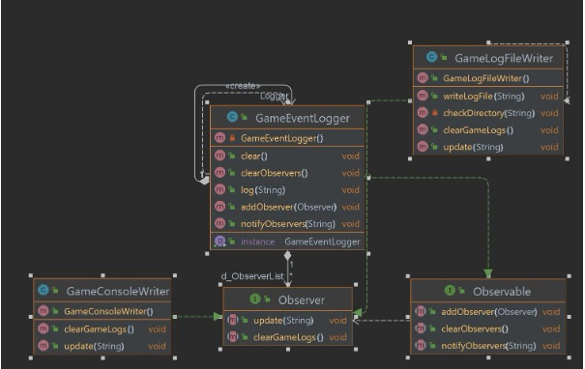
Logger

Slide 23
Logger
GameEventLogger.java
The GameEventLogger class facilitates logging of game events by initialising a GameLogFileWriter for writing log entries.
GameLogFileWriter.java
The GameLogFileWriter class is responsible for writing log entries to designated log files
Observable.java
The Observable interface outlines a contract for objects that can be observed by other components.
Observer.java
The Observer interface defines a contract for objects that observe and react to changes in other objects, typically implemented in the observer design pattern.
GameConsoleWriter.java
The GameConsoleWriter clears the current gamelogs and updates the string.

Slide 24
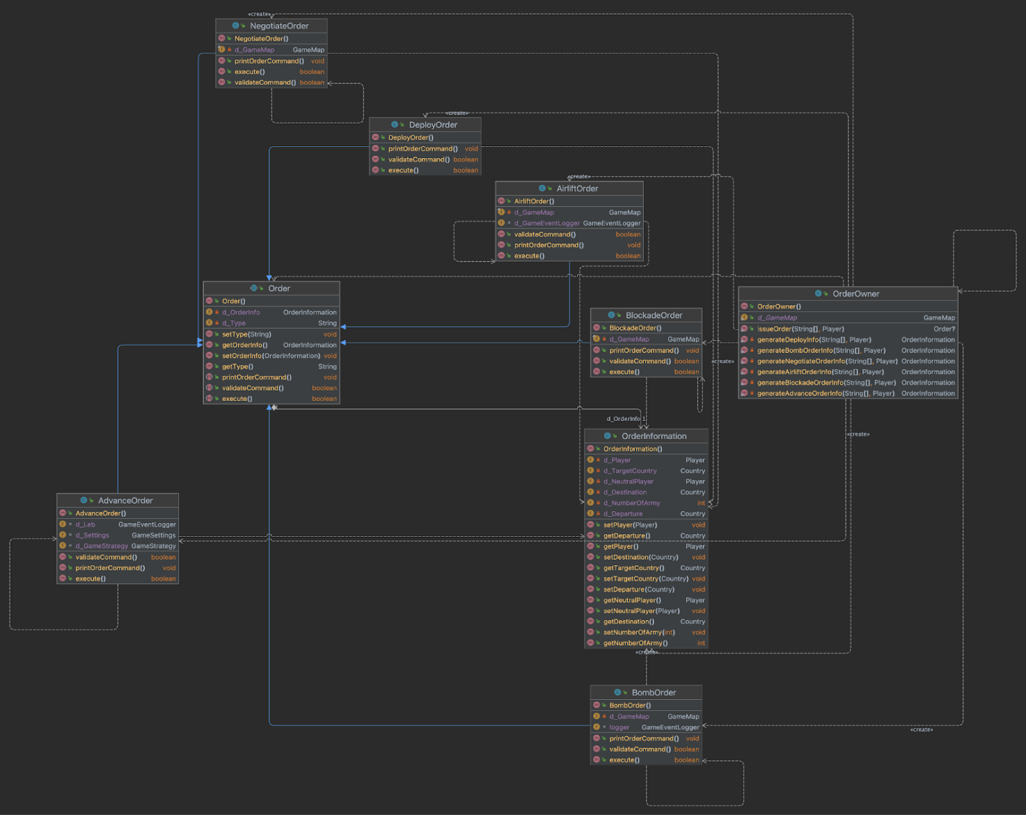
Orders
The orders have been implemented using a command pattern in which the parameters setType and execute are used respectively to set the command type and execute commands.

Slide 25
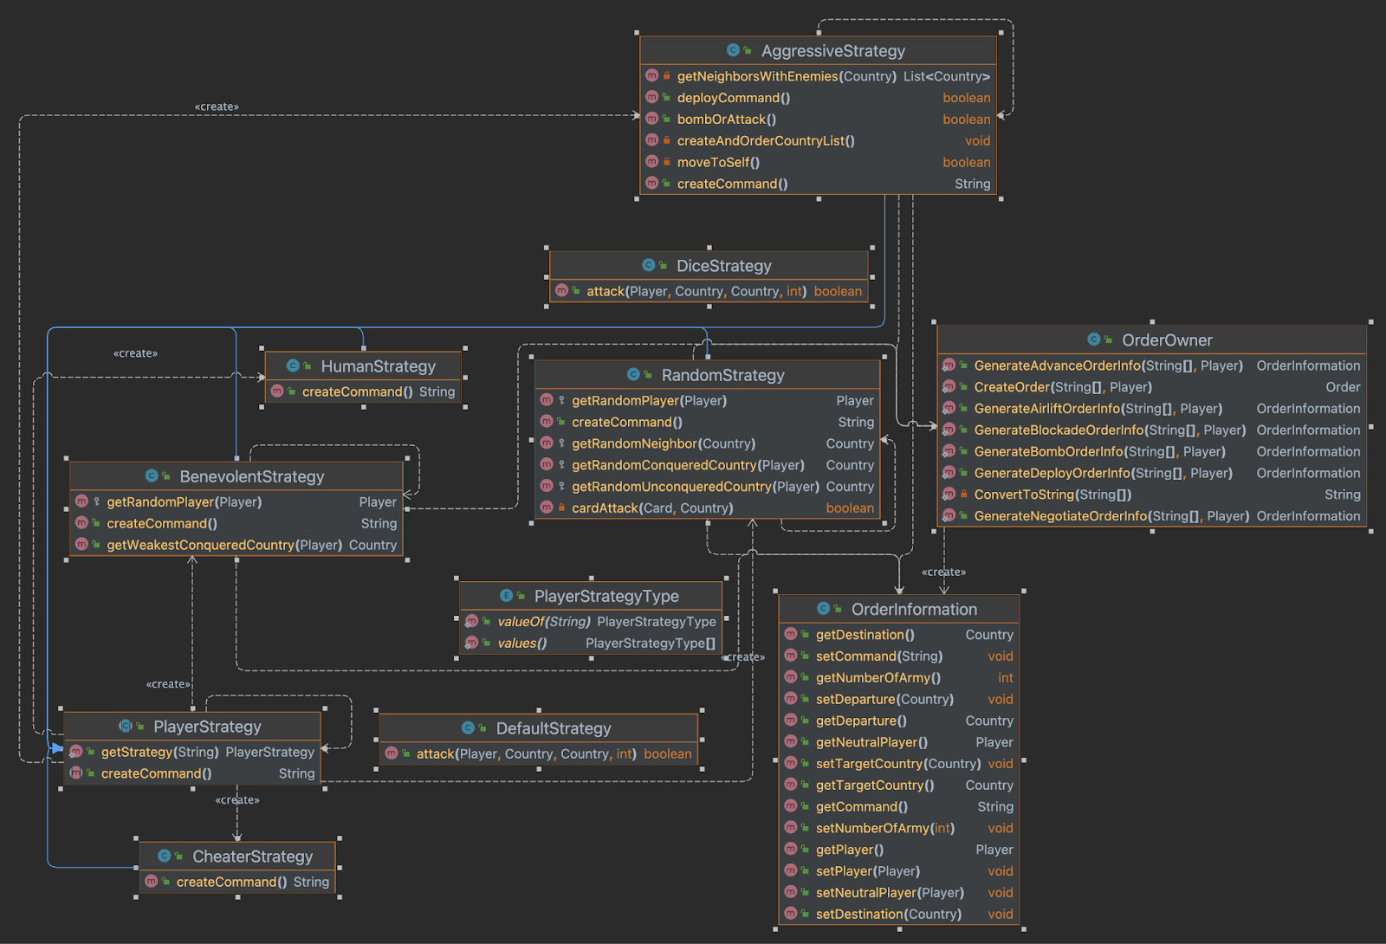
Strategy
The Strategy pattern enables flexible and adaptable player behaviour during gameplay.

Slide 26
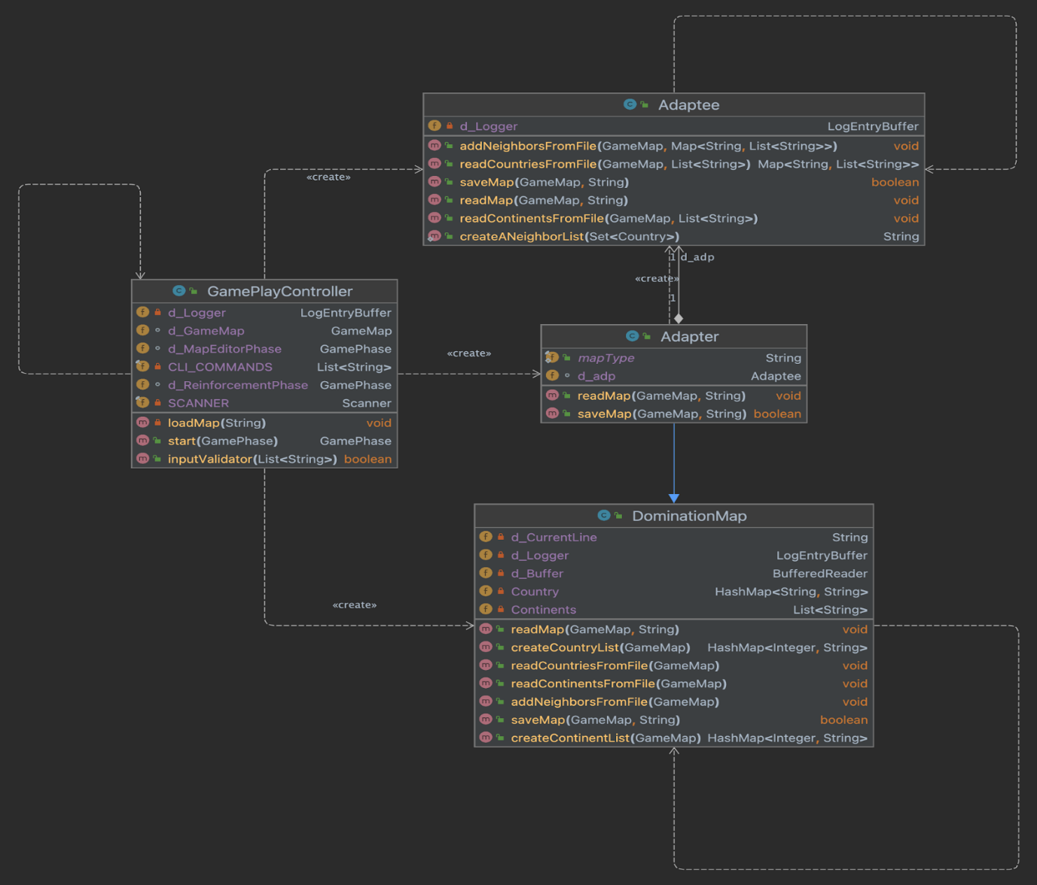
Adapter
The Adapter pattern provides a bridge between classes which have similar functionality but incompatible interfaces, facilitating their collaboration.

Slide 27
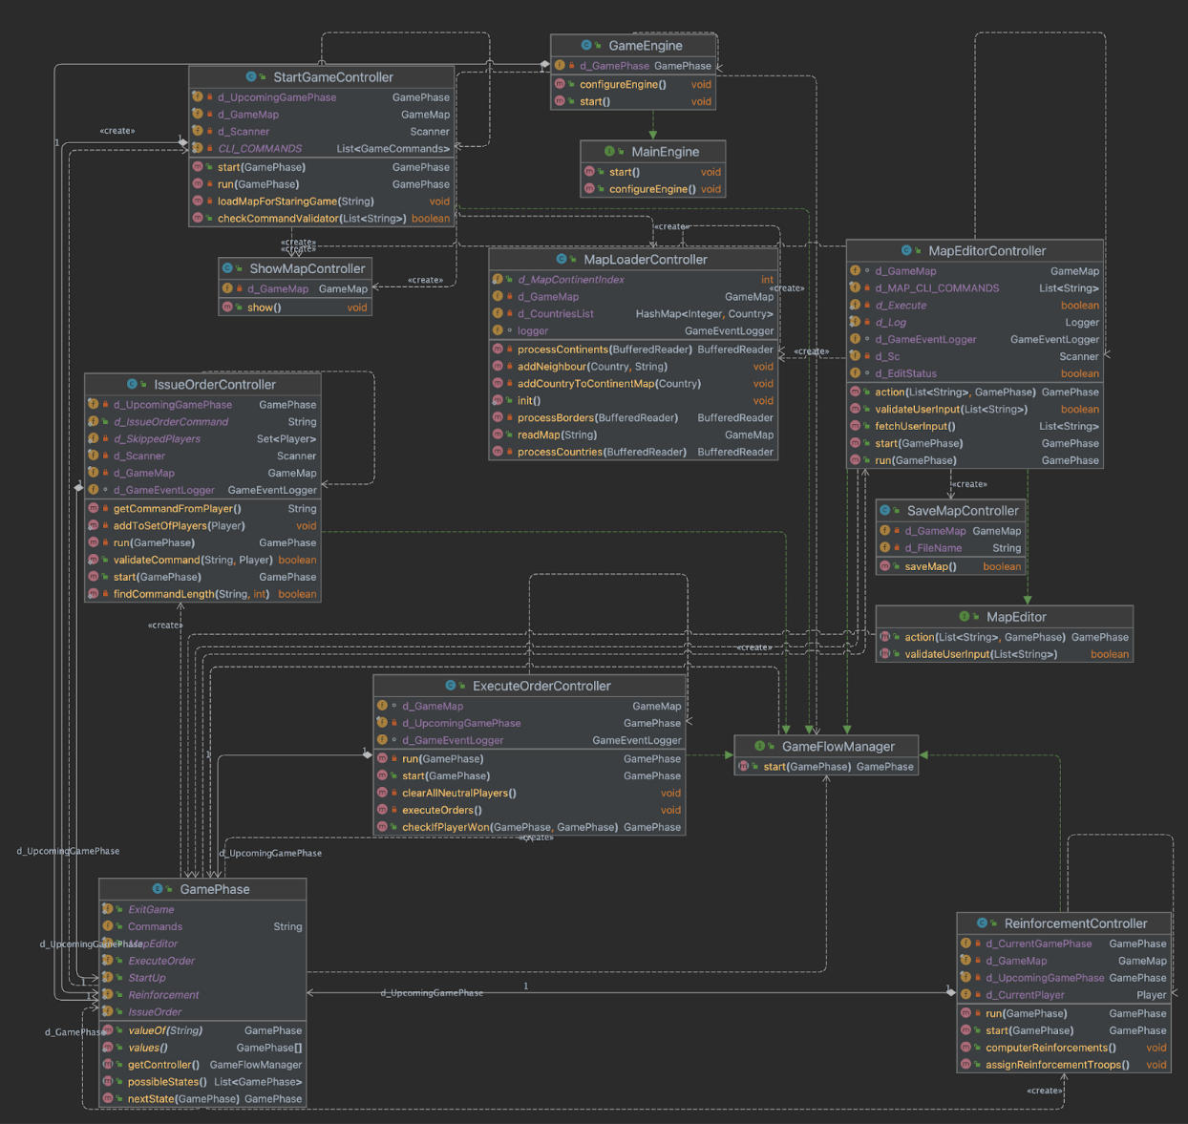
GamePhase
The GamePhase will be managed by the GamePhaseManager primarily to change phases of the game.

Slide 28
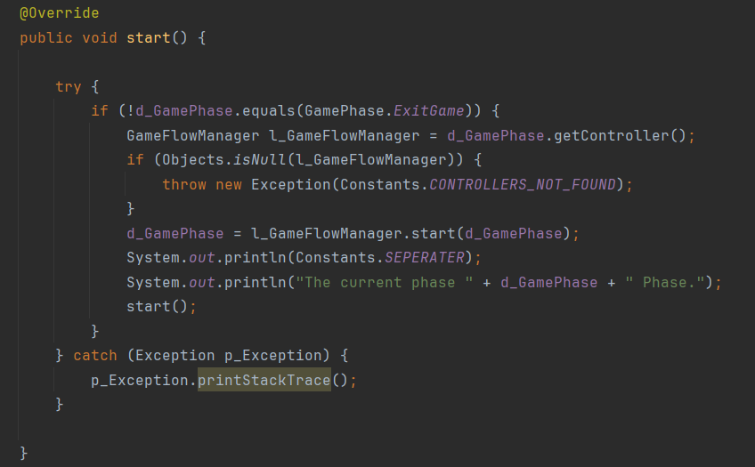
Game Flow
Here it checks for the condition until the Exit Phase and makes sure that all the phases of the game are implemented serially.

Slide 29
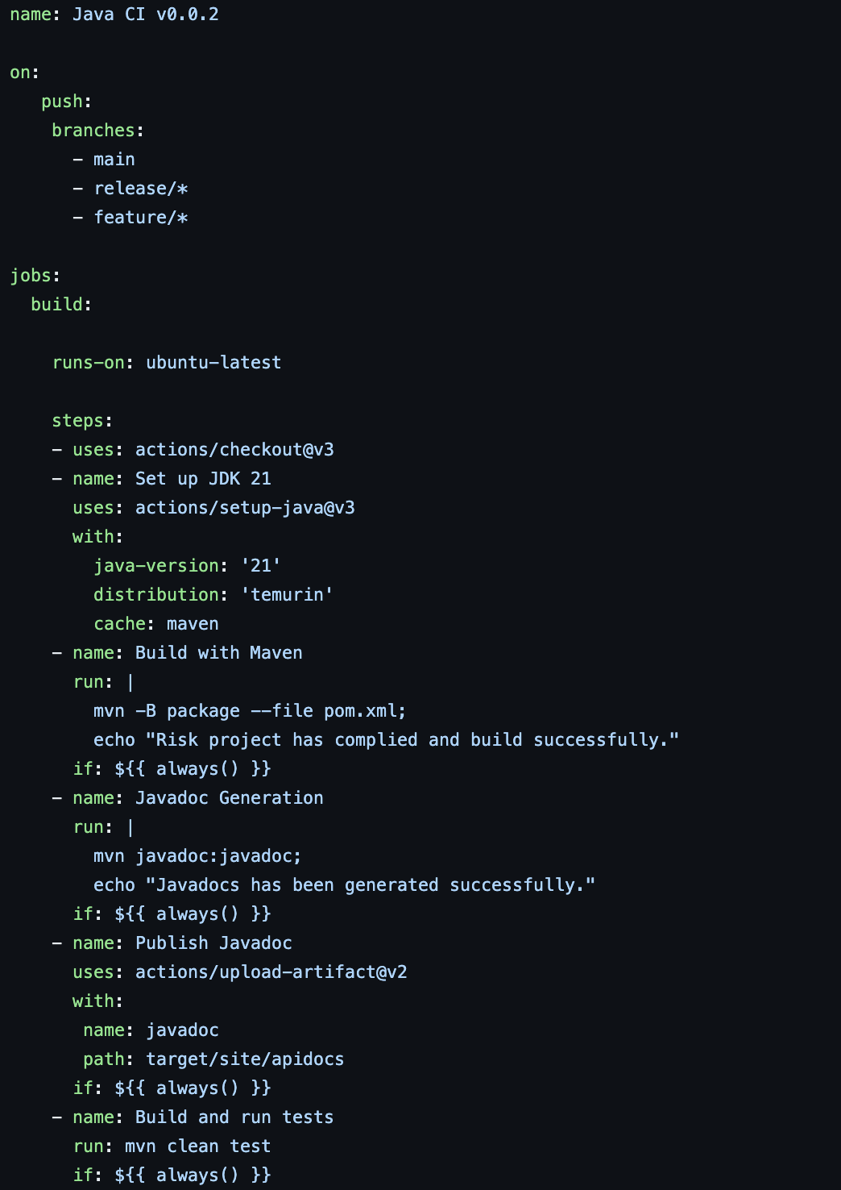
Continuous Integration
This consists of total Five steps:
Checkout
Build With Maven
Javadoc Generation
Publish Javadoc to artifacts
Build and run test

Slide 30

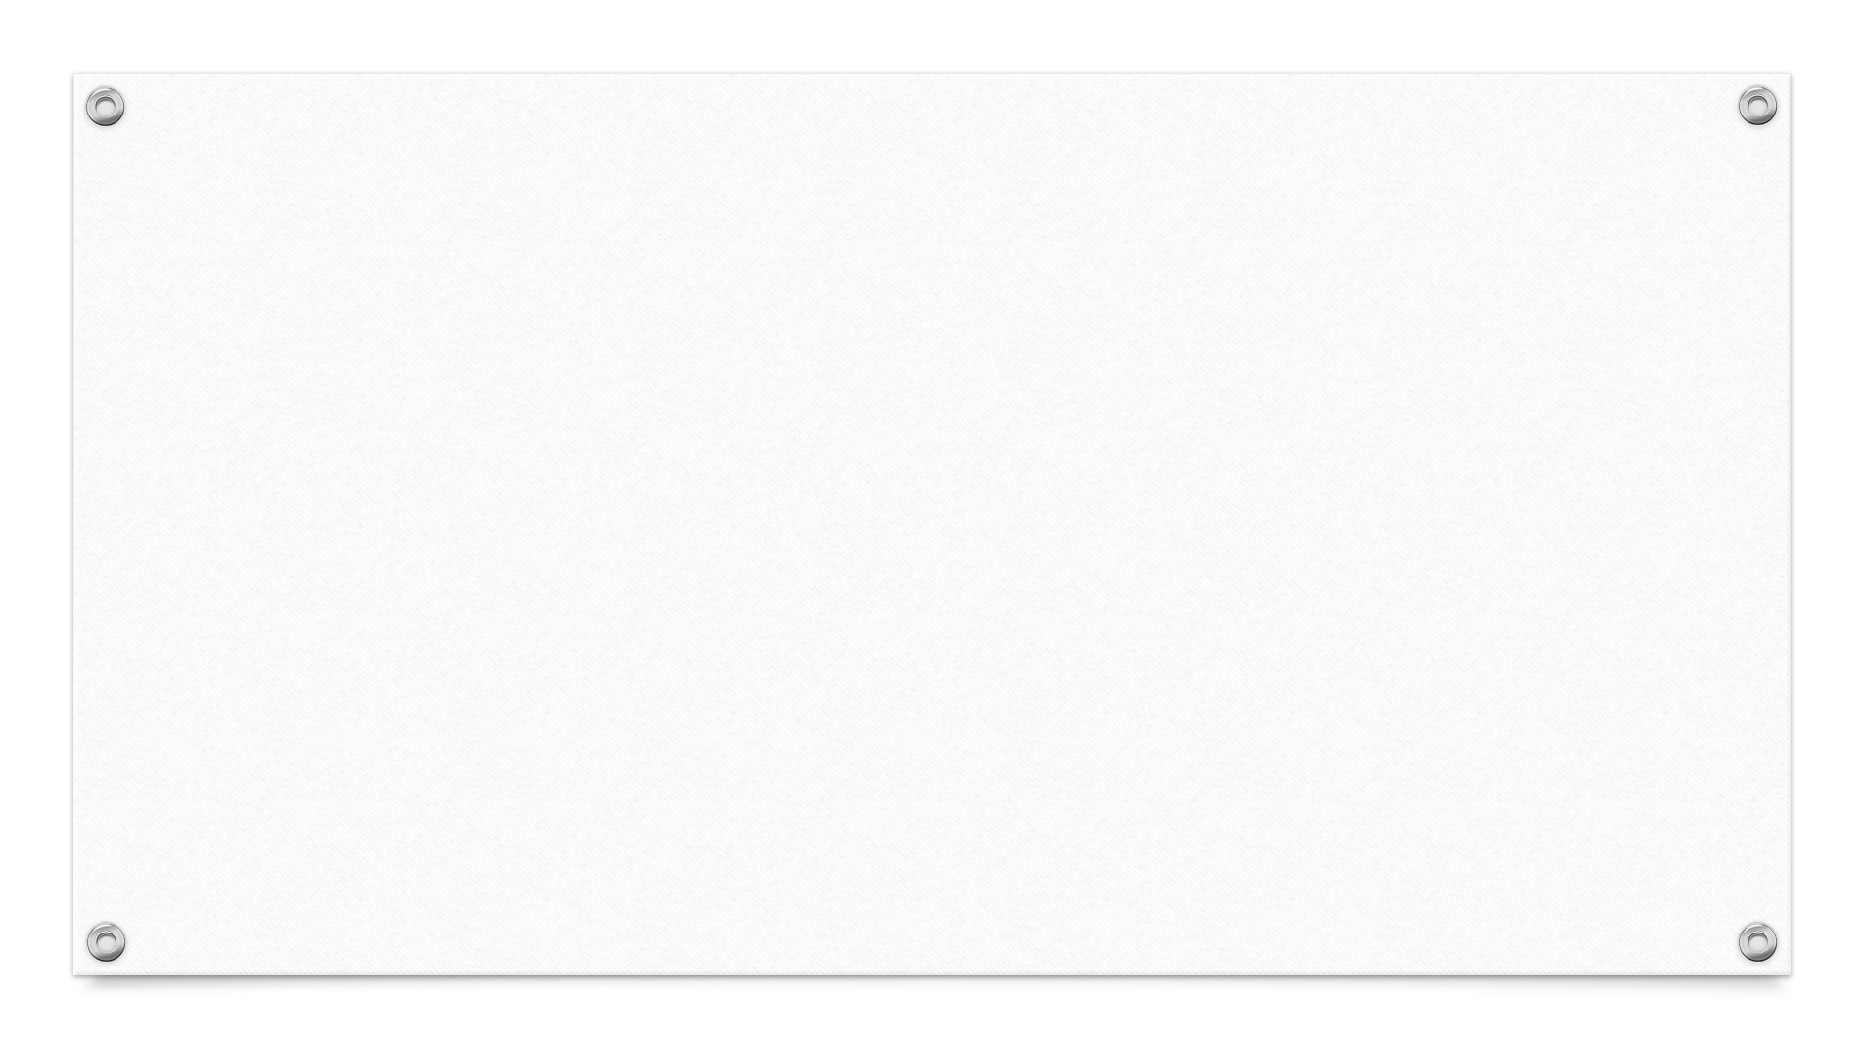
Testing
Here we are using JUnit version 4 for our testing purpose.
We have tested few models such as country, continent, game map, player.
We have also done test for the Card, GameCommands and for the Player.
On top of that, we have also tested controller such as IssueOrderController, MapEditorController, MapLoaderController, ReinforcementController, StartGameController.
In this build we have implemented test cases for various orders such as AdvanceOrder, AirliftOrder, BlockadeOrder, BombOrder, DeployOrder, NegotiateOrder.
We have also validated map with help of map validator test.

Slide 31
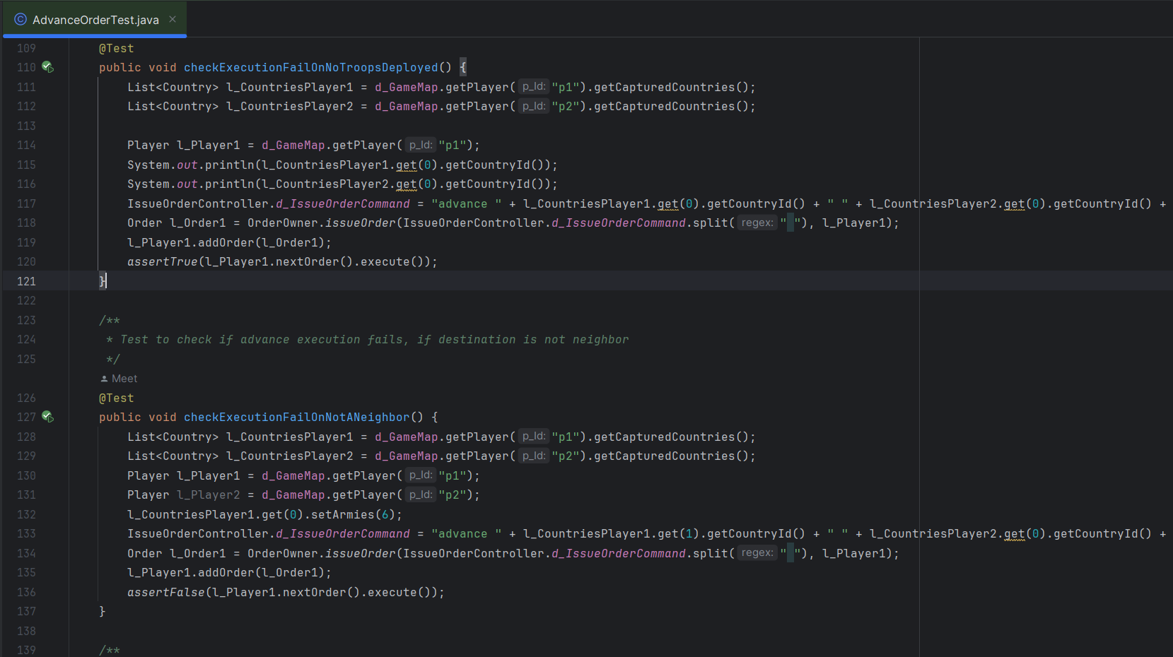
Advance Order Test

Slide 32
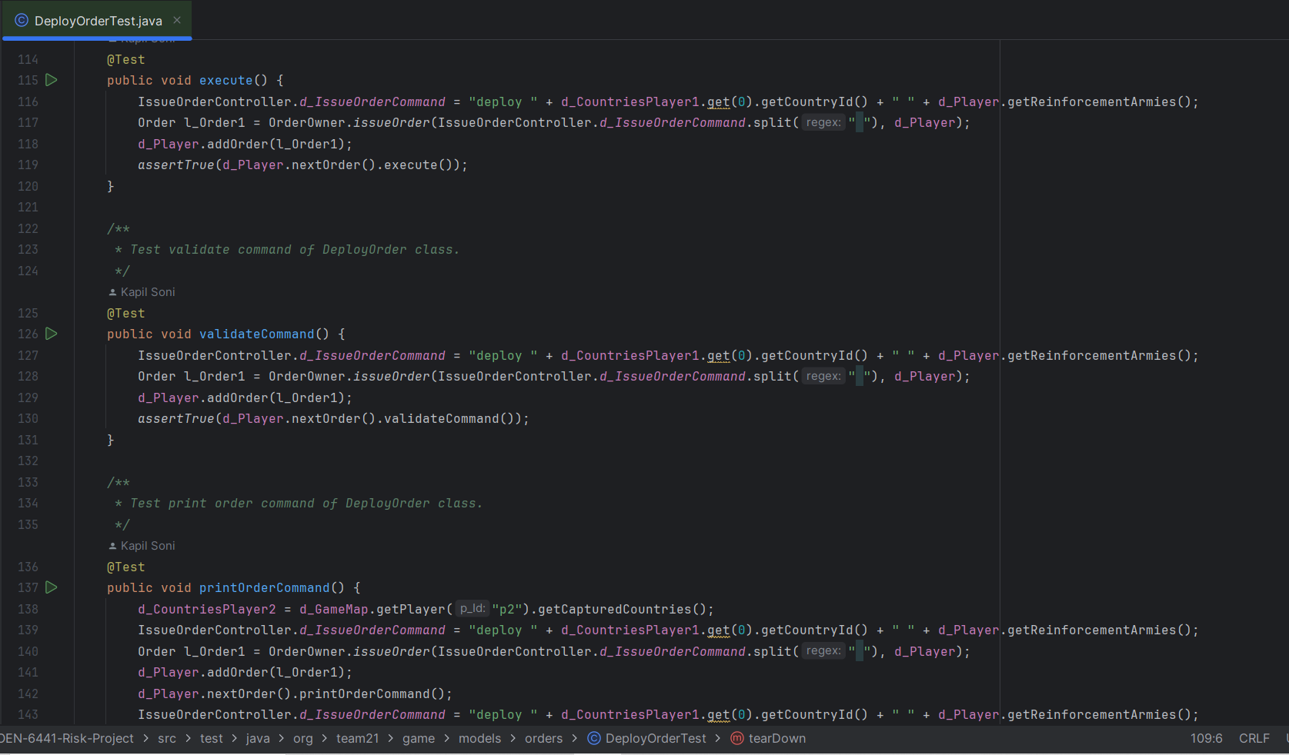
Deploy Order Test

Slide 33
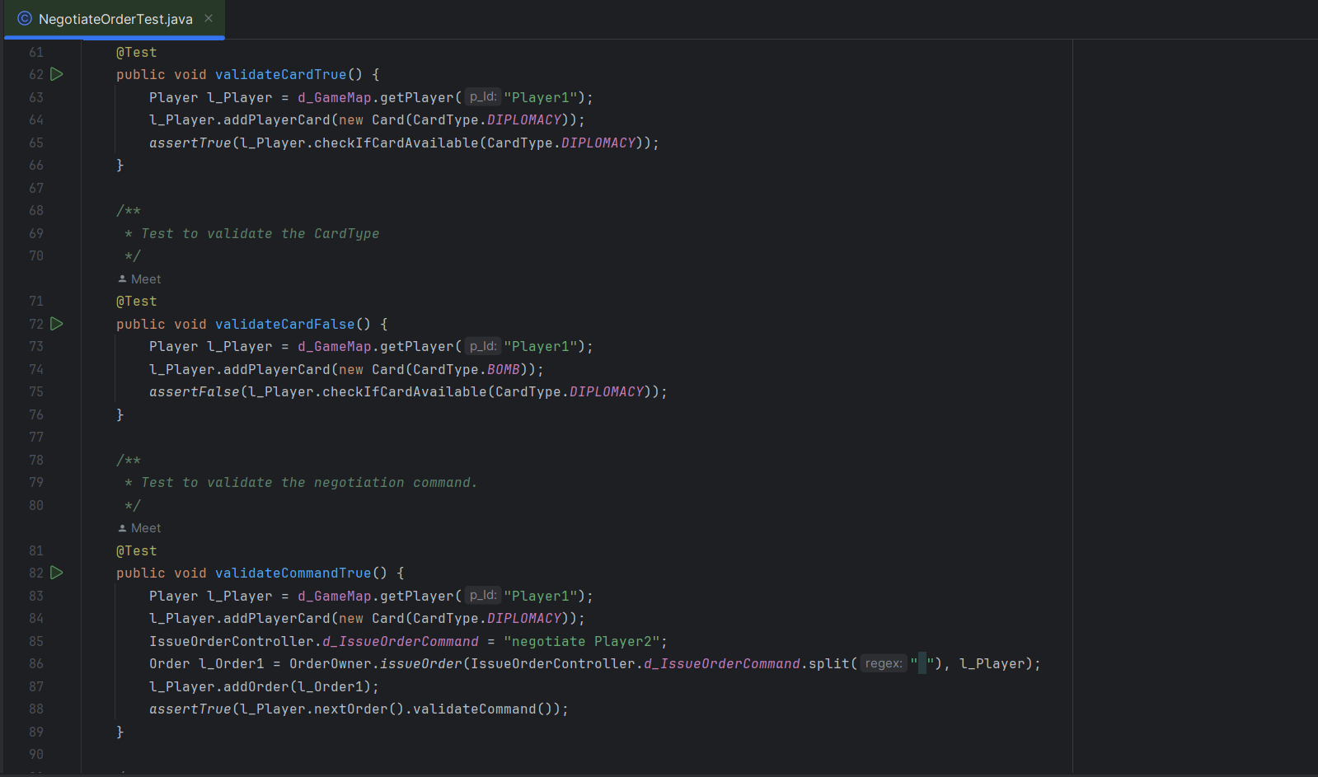
Negotiate Order Test

Slide 34
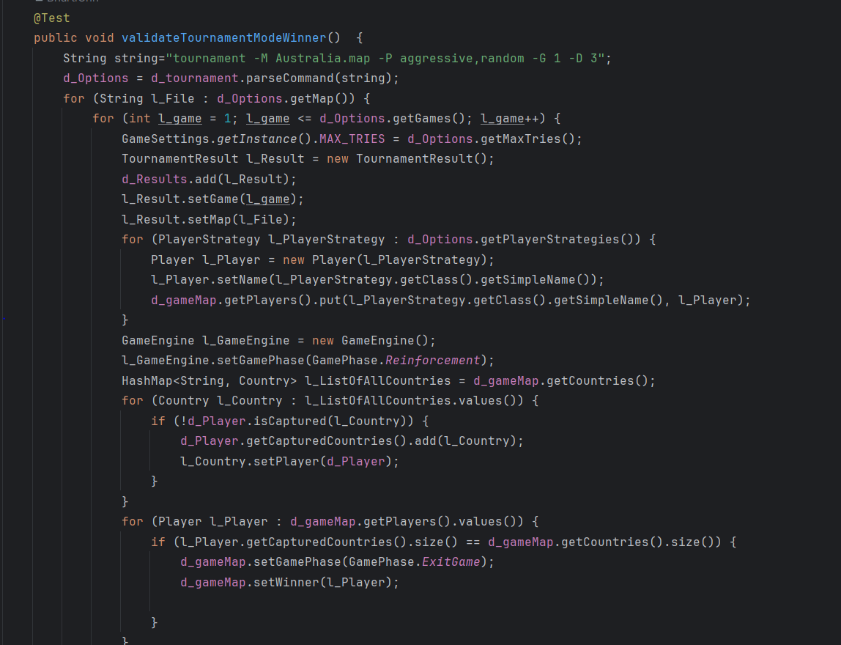
Tournament Mode Test

Slide 35
THANK YOU

